Slide 1
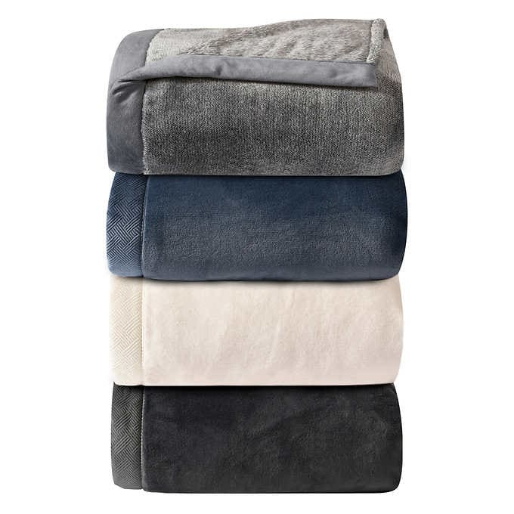
Food & Toiletries Donations
Blanket Express Returns to Superior Township!
To Help: Blankets – Must Be New
Food – Must be Non-Perishable Food
Drop-off Dates: November 28th - December 21st
Location: Superior Township Hall
The blankets and food will be donated to community organizations that serve as a helping agent to those in need. If you need more information, contact:
Treasurer, Lisa A. Lewis at (734) 482-6099.

